Slide 1
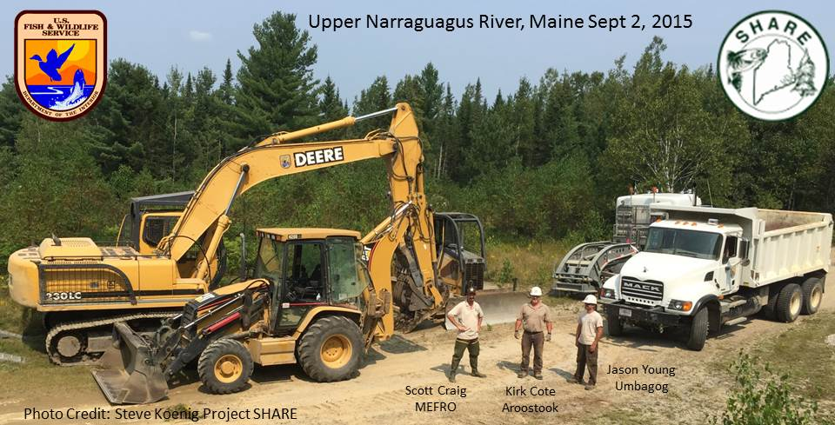

Slide 2
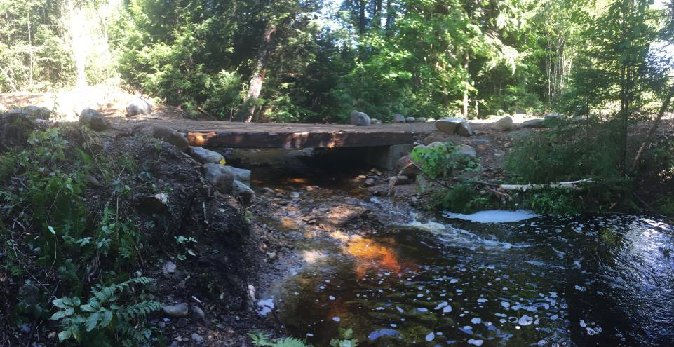


16 ft Hemlock Timber Bridge Deck with 2 rows of Concrete Footers (14 footer blocks)
Photo’s by Scott Craig
Northern Stream Tributary (East Machias River) September 2015

Slide 3
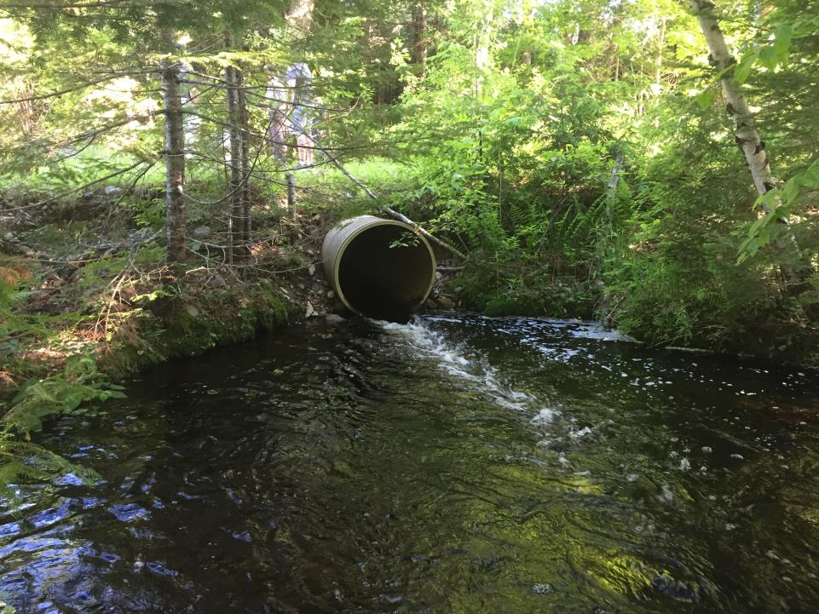
Structure before- Single fiberglass round pipe
Velocity barrier to Alewife and Salmonids

Slide 4
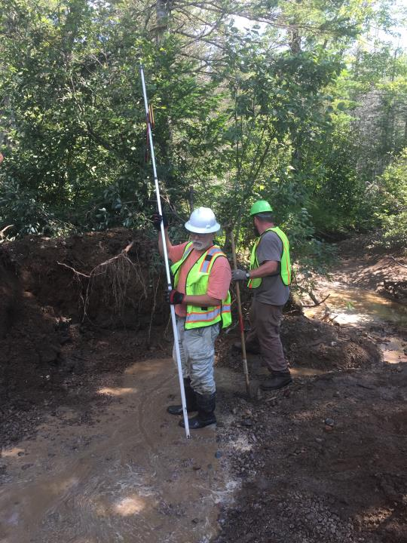

Slide 5
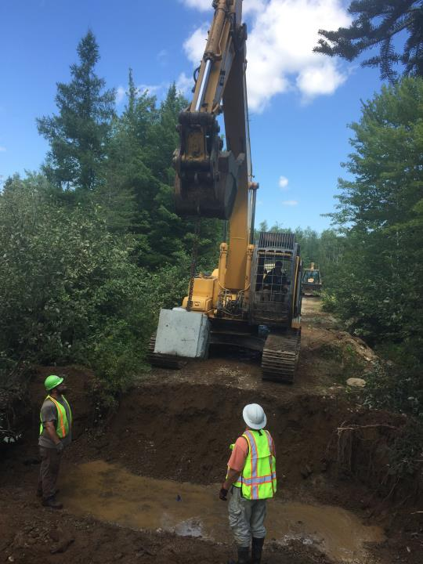
Moosehorn
Refuge
Equipment and Operator

Slide 6
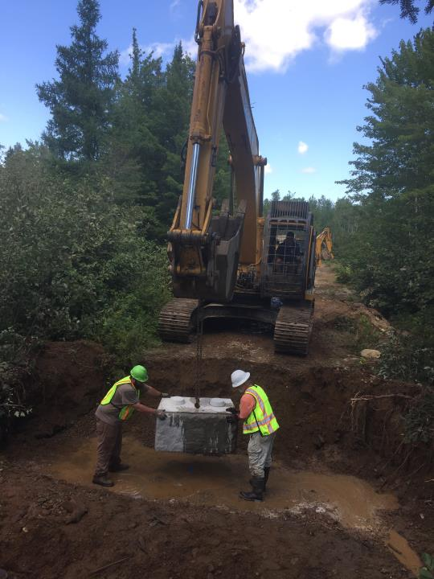
Moosehorn
Refuge
Equipment and Operator

Slide 7
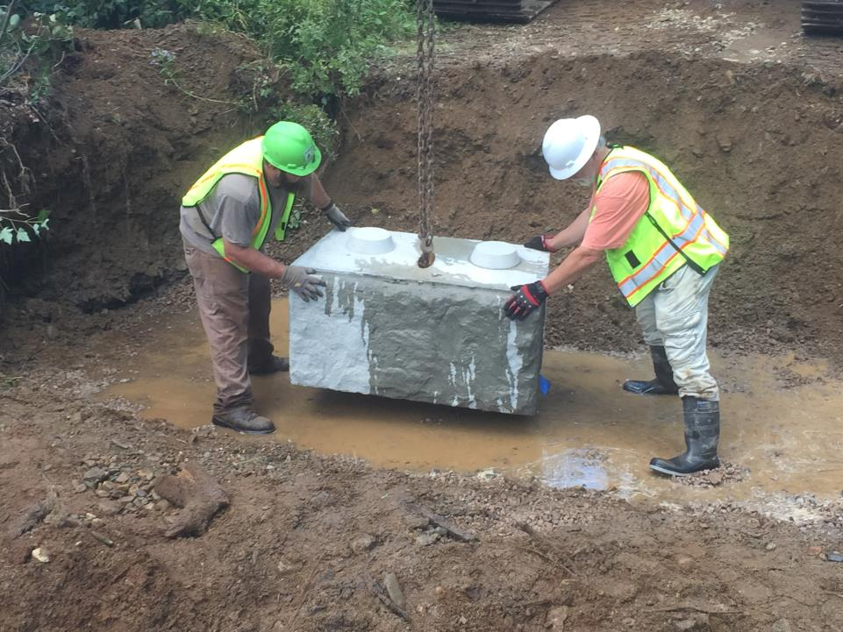

Slide 8
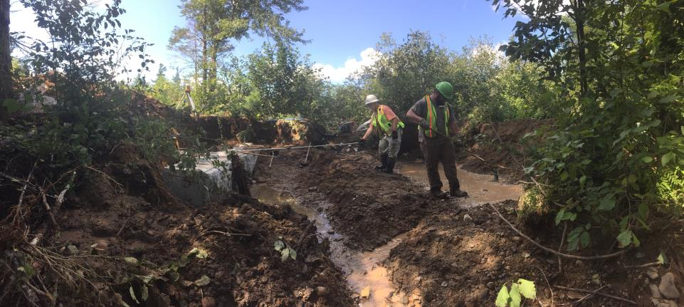

Slide 9
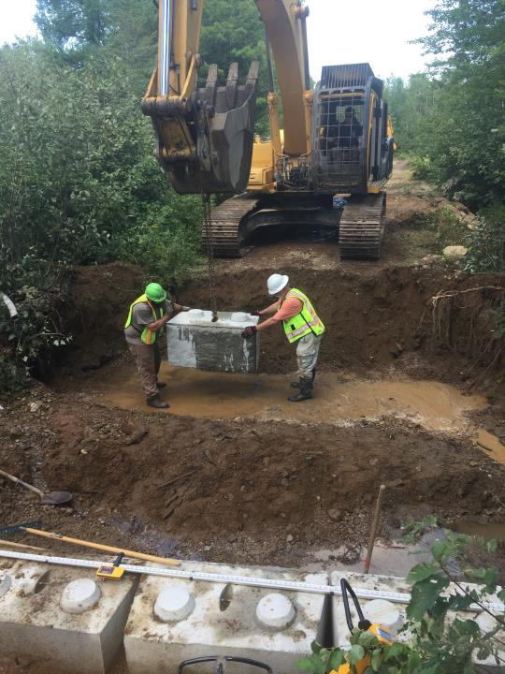

Slide 10
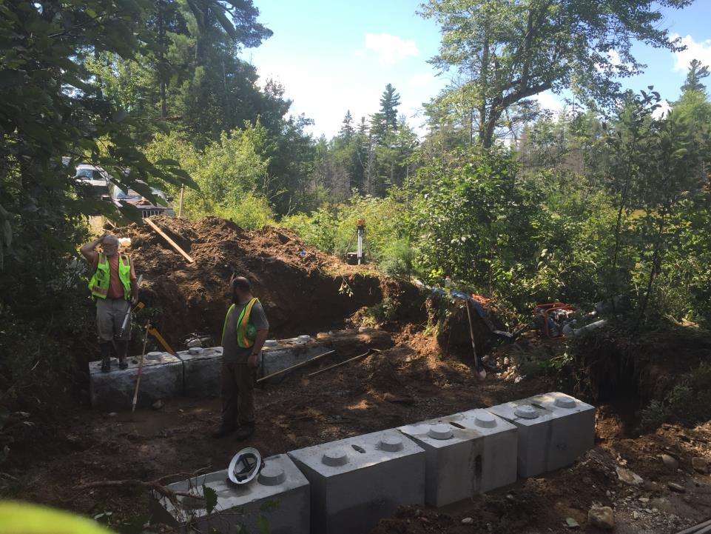

Slide 11
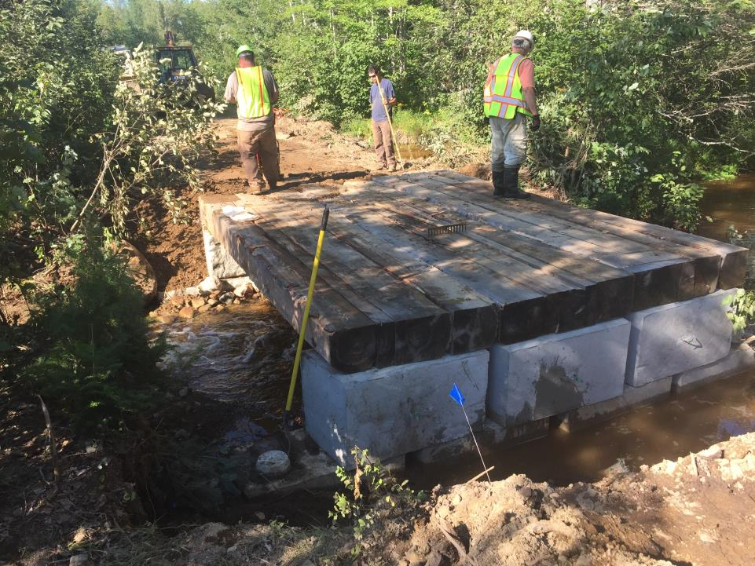

Slide 12
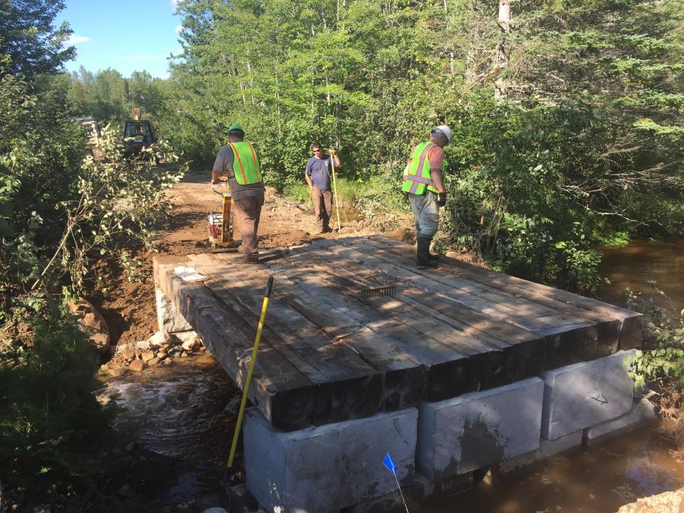

Slide 13
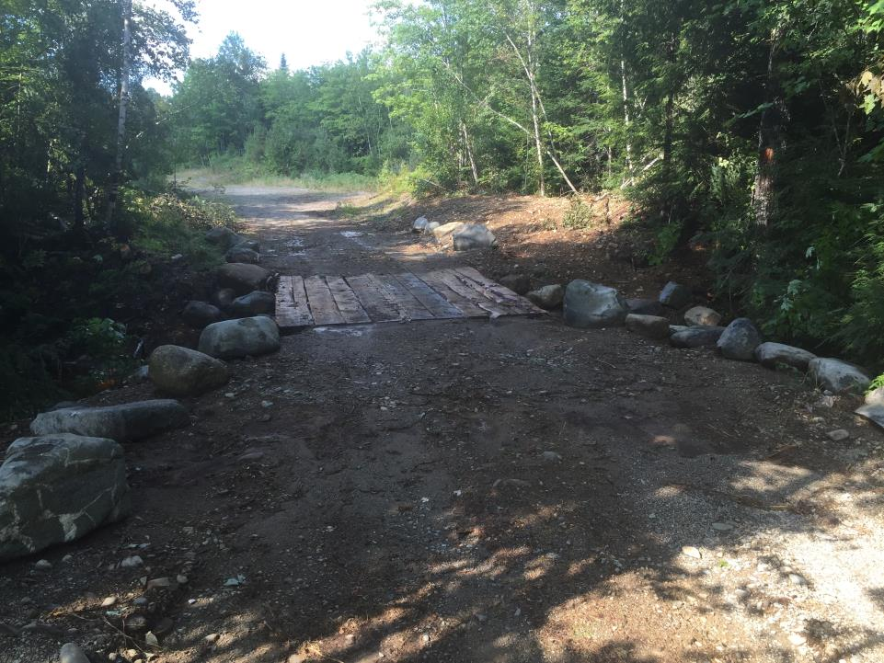

Slide 14
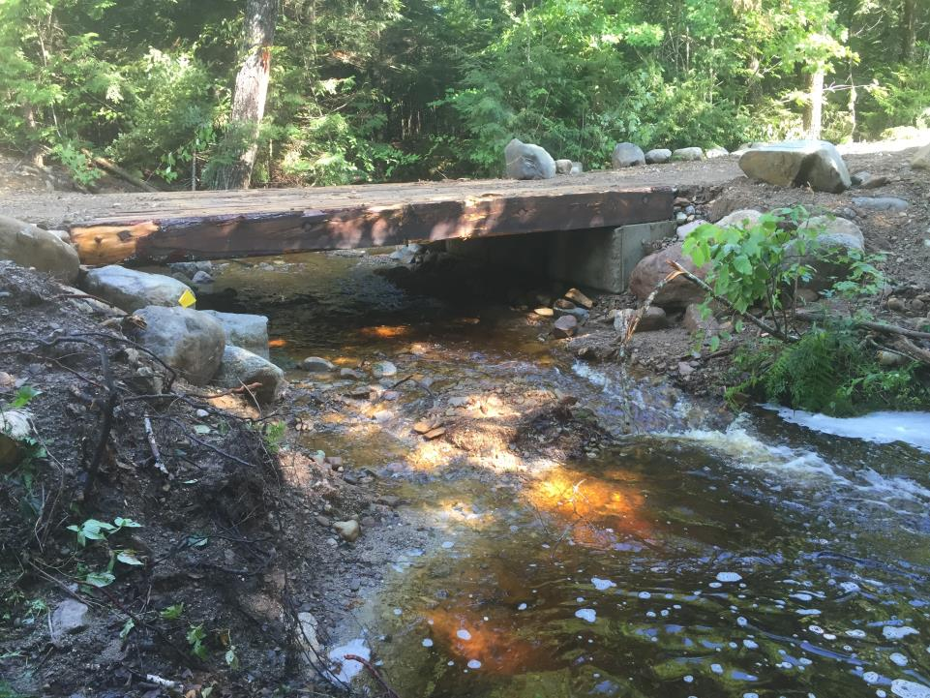
After

Slide 15
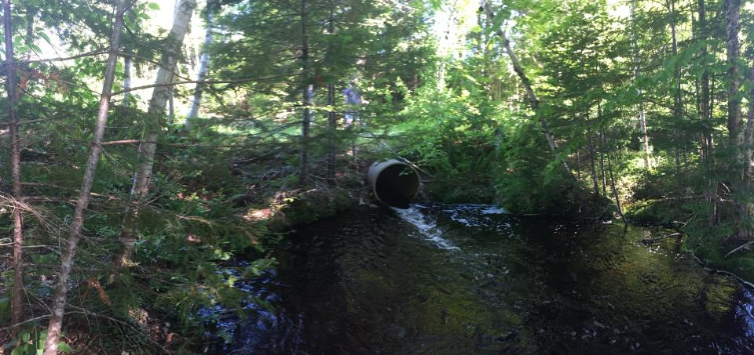
Before

Slide 16
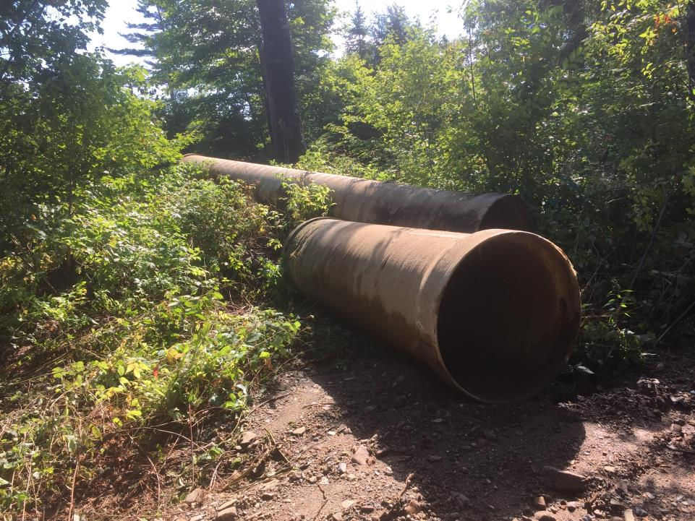
Old water Control Pipes

Slide 17
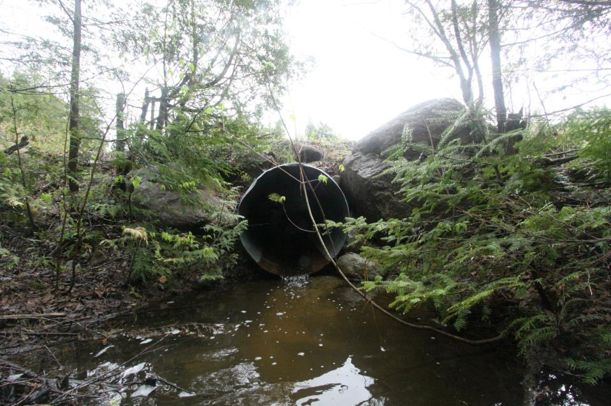
Narraguagus River
Tributary
45:000 Road Culvert Before
June 2014

Slide 18
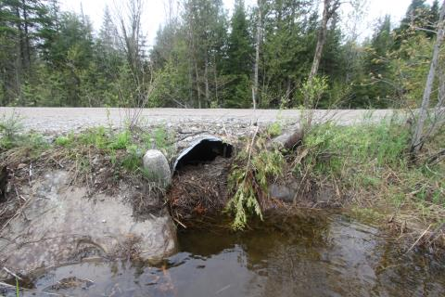
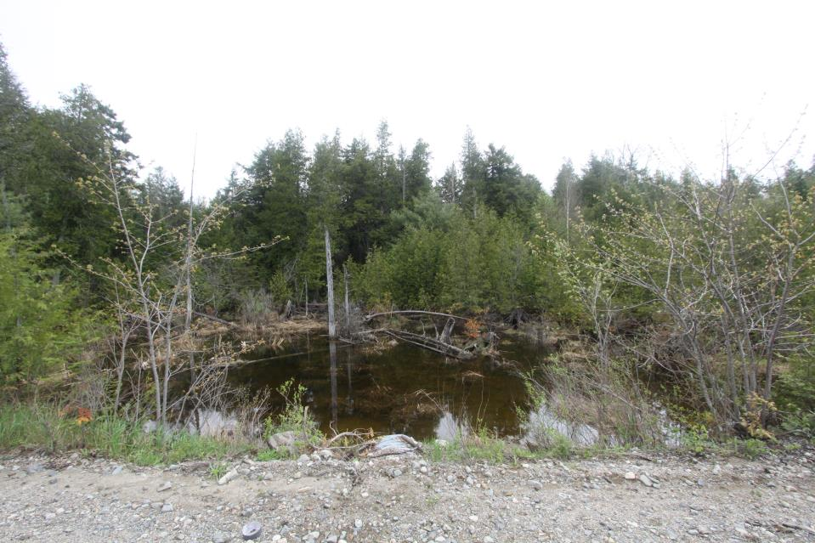
June 2014
45:000 Road Culvert Looking upstream
Inlet

Slide 19
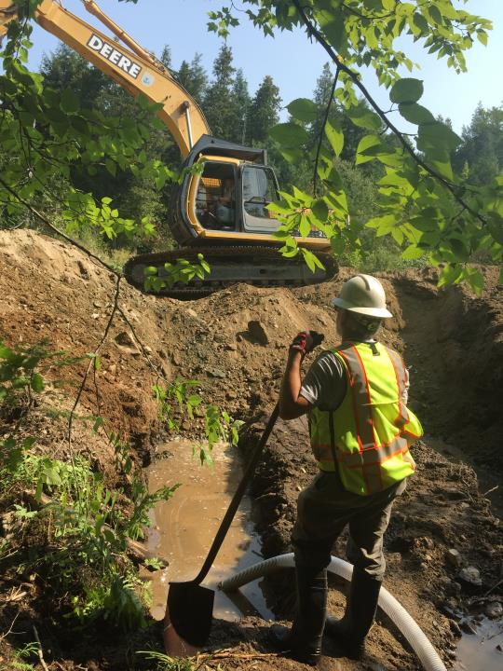
45:000
Road
Culvert
Replacement
August
2015
SHARE
USFWS
Fisheries
&
Refuge
Staff

Slide 20
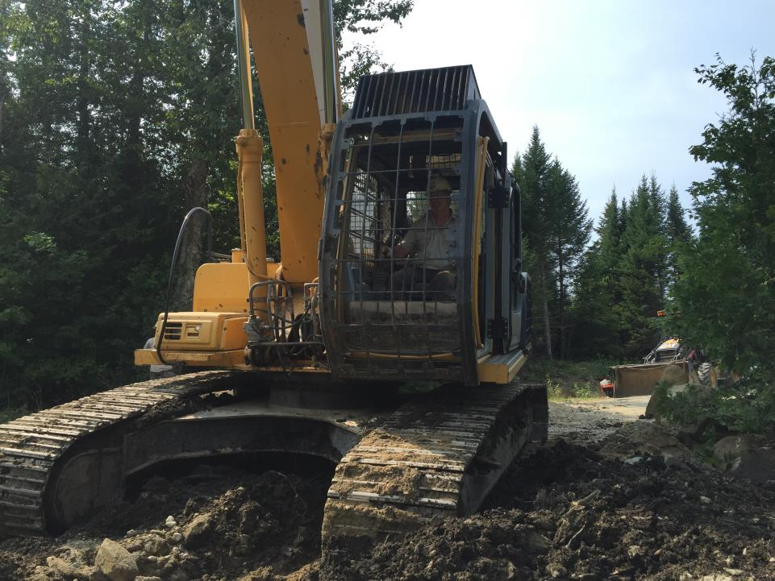

Slide 21
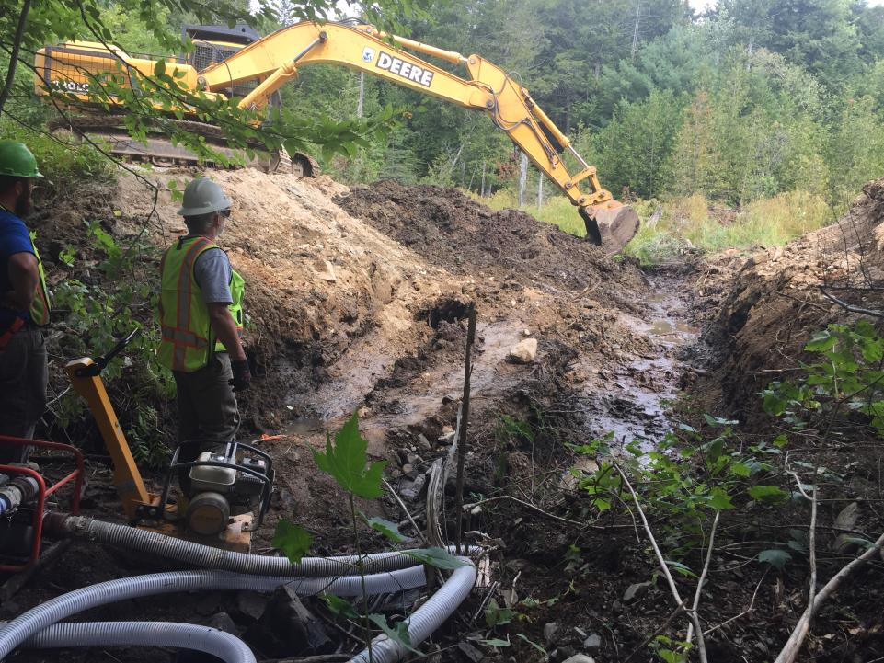

Slide 22
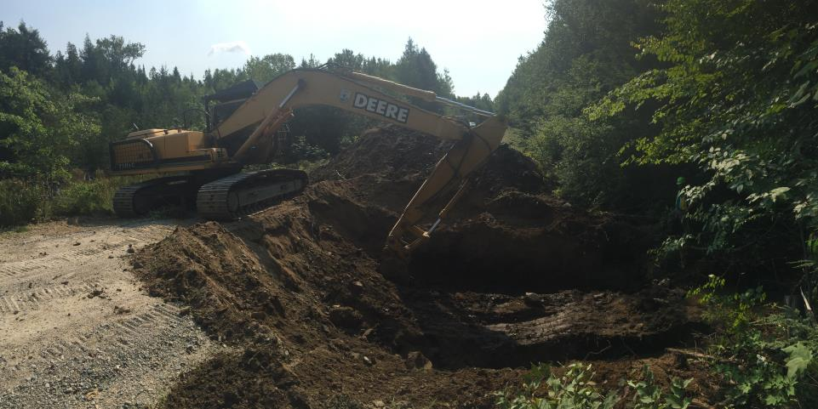

Slide 23
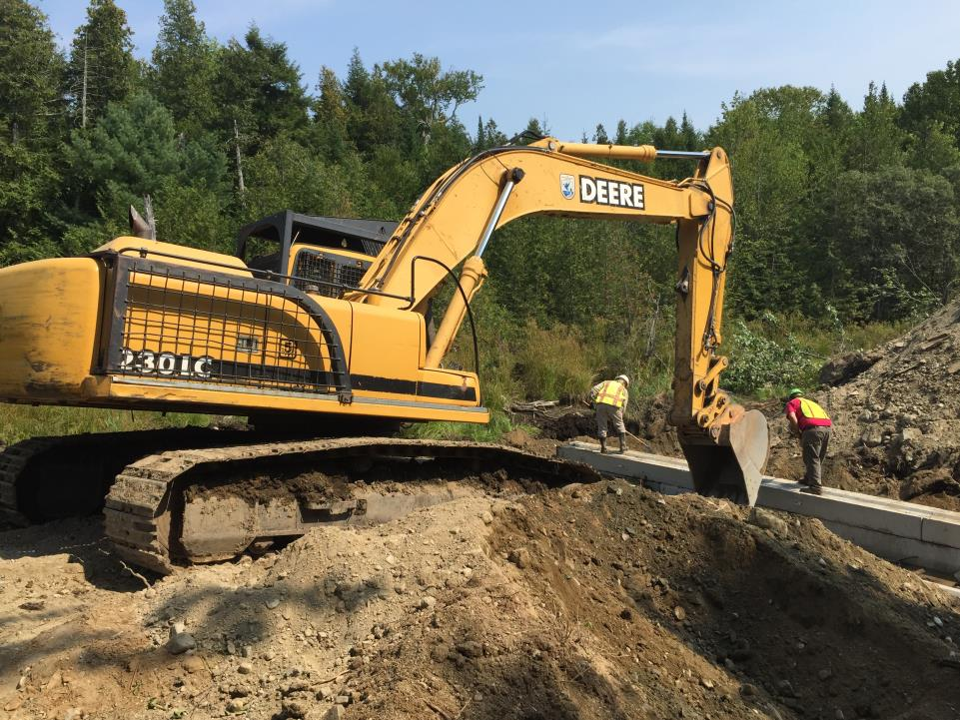

Slide 24
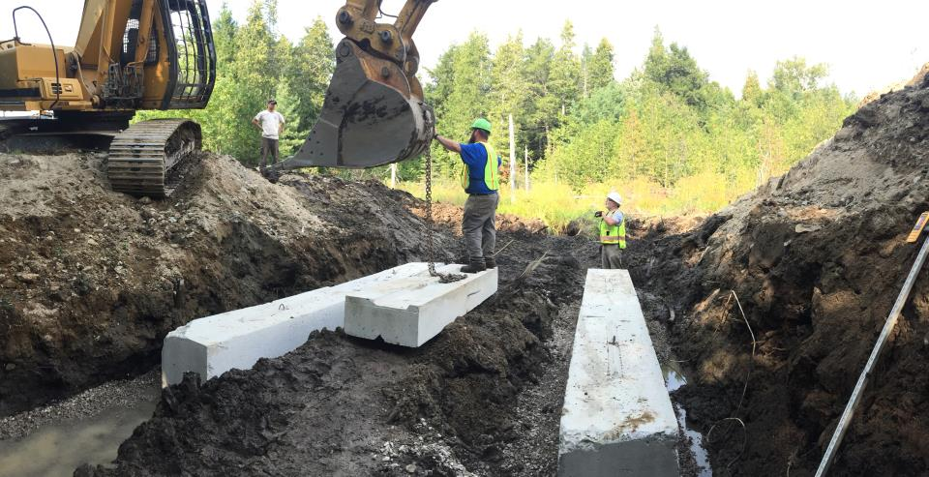

Slide 25
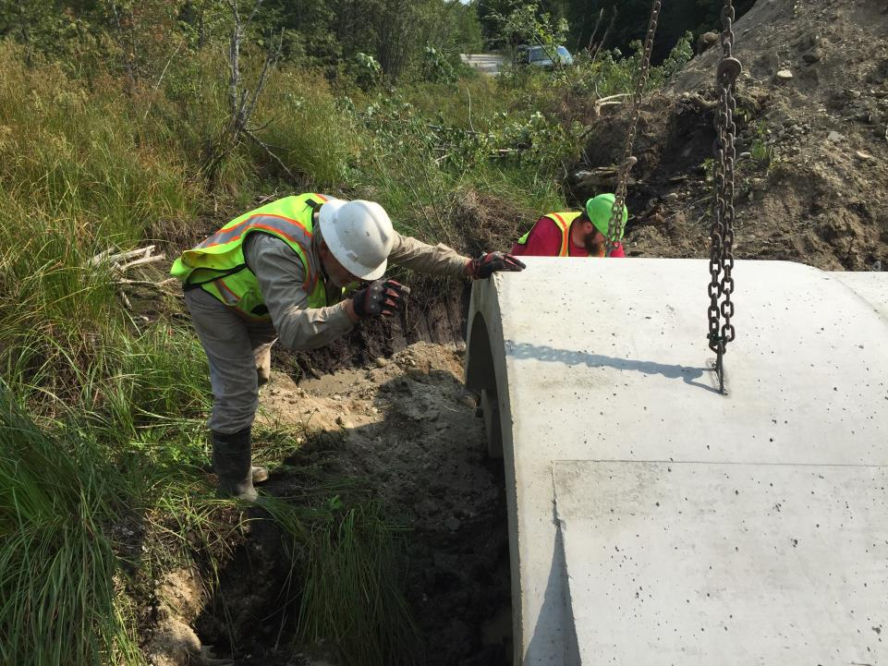

Slide 26
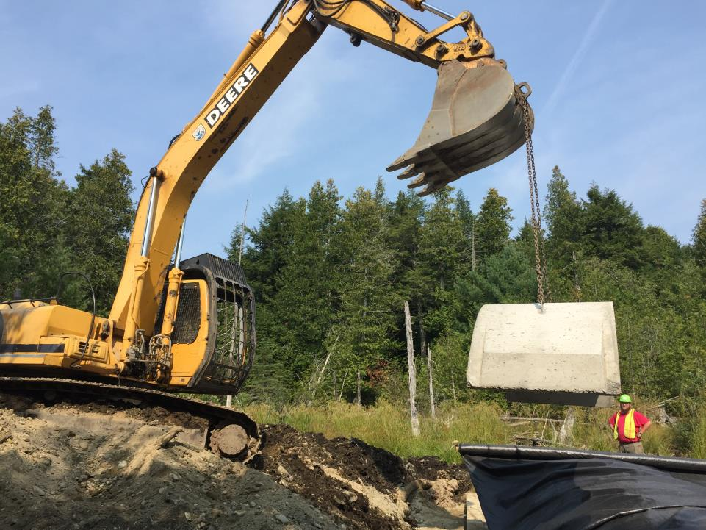

Slide 27
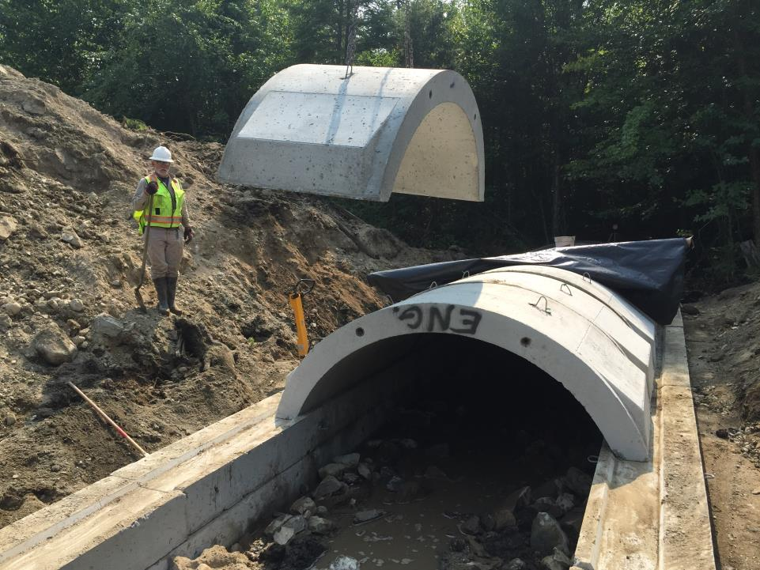

Slide 28
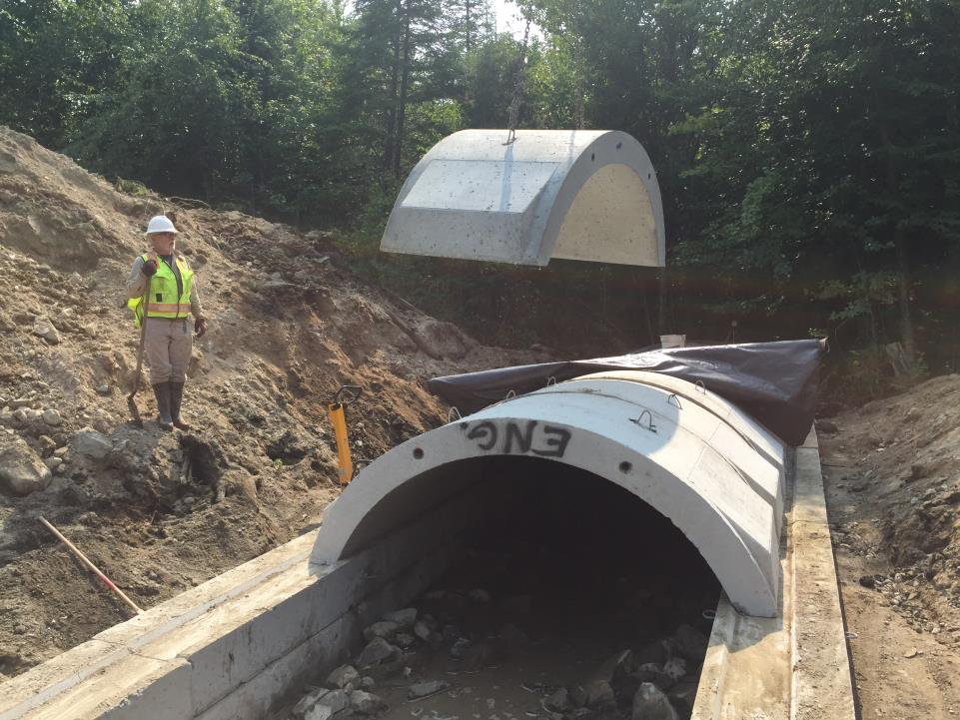

Slide 29
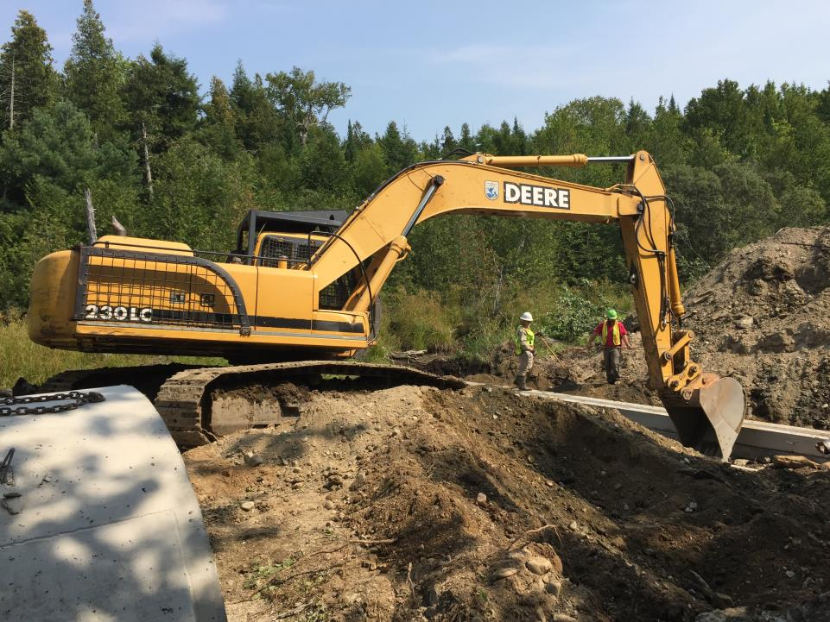

Slide 30
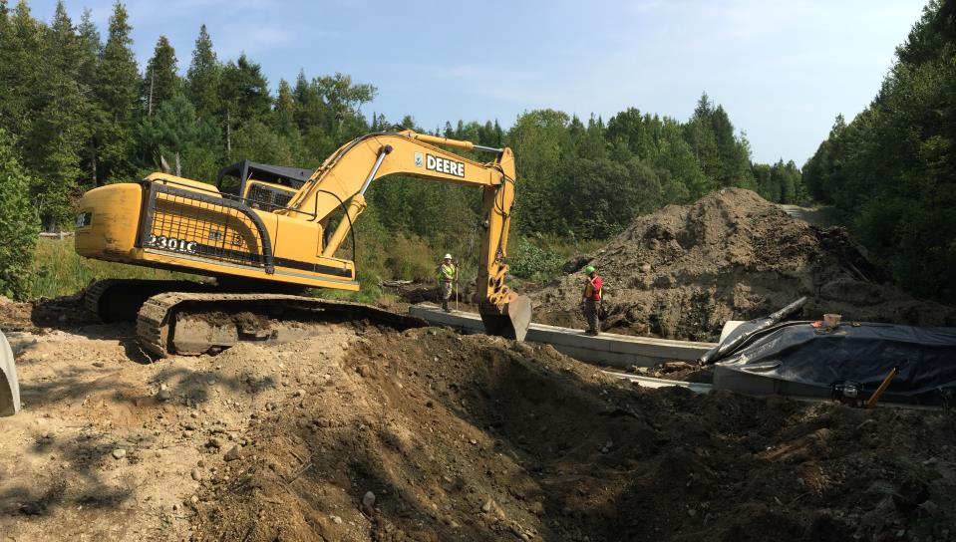

Slide 31
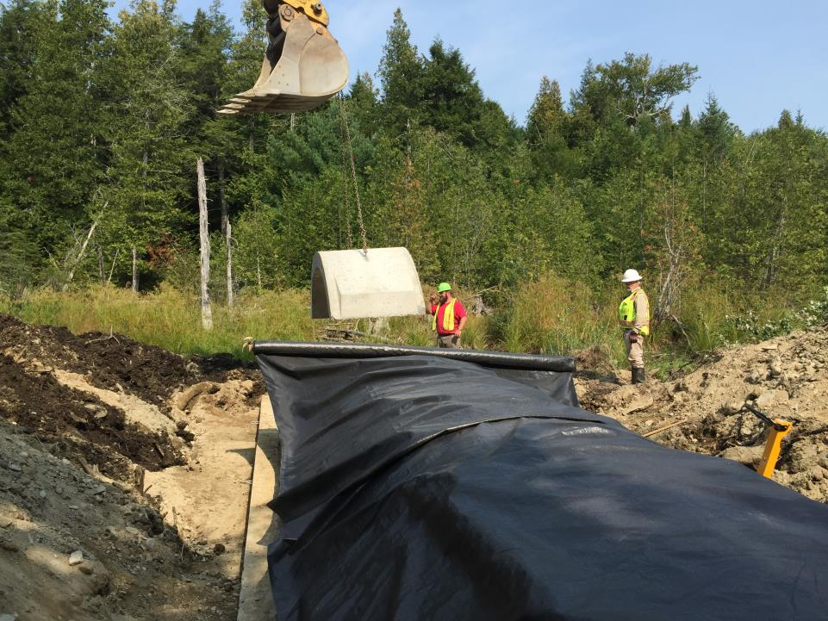

Slide 32
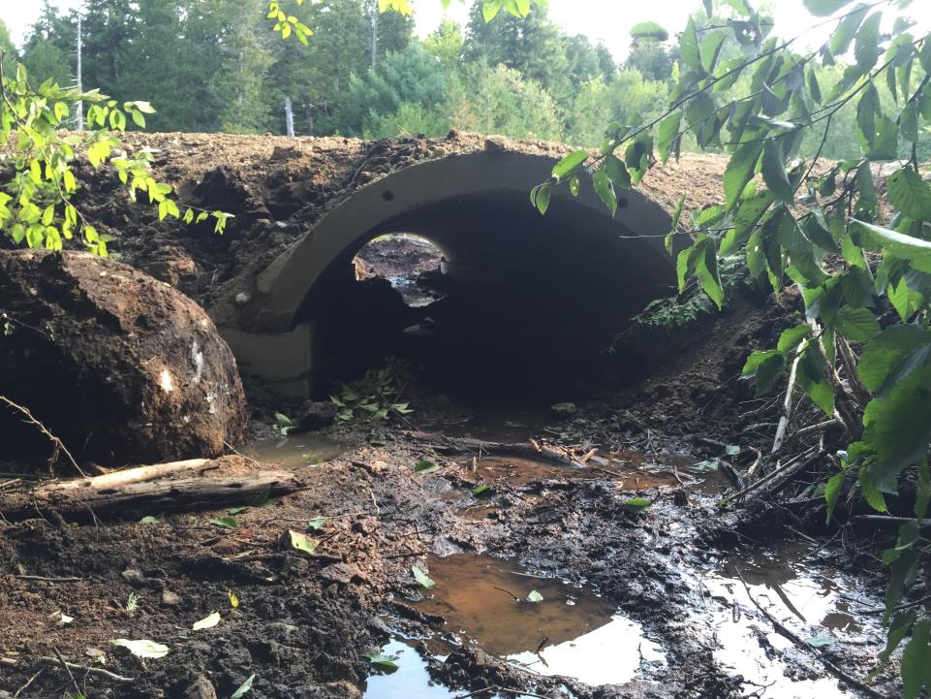
After 8 ft wide open arch

Slide 33
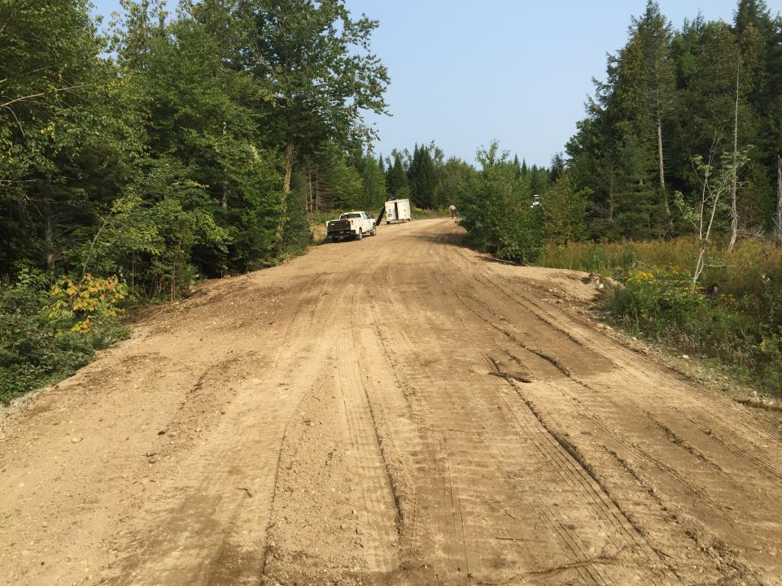
After 45:000 Road

Slide 34
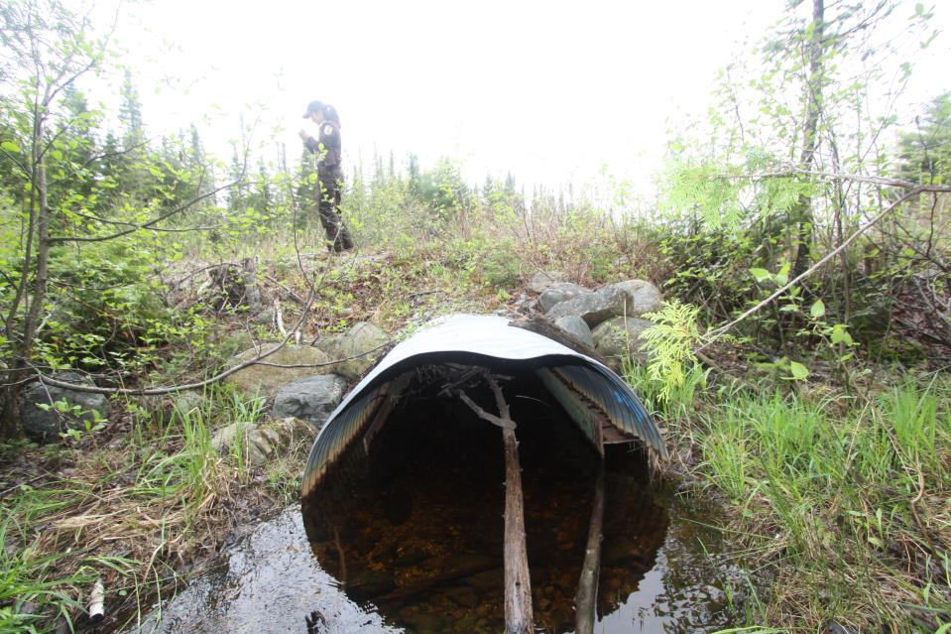
45:000 Spur Road Tributary to Bracey Pond
Outlet
June 2014

Slide 35
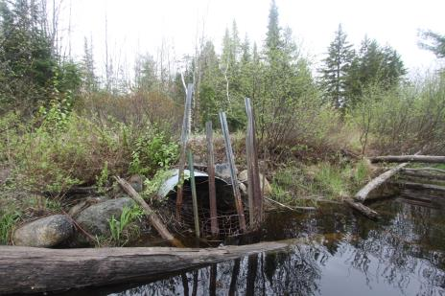
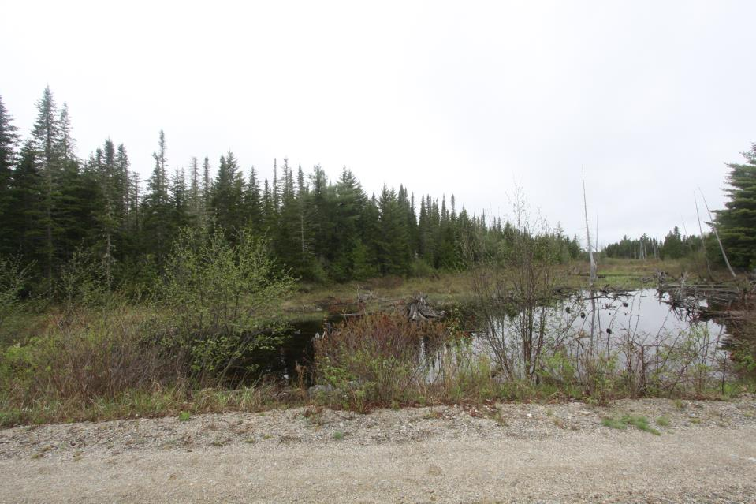
45:000 Spur Road Tributary to Bracey Pond
Looking upstream June 2014
Inlet

Slide 36
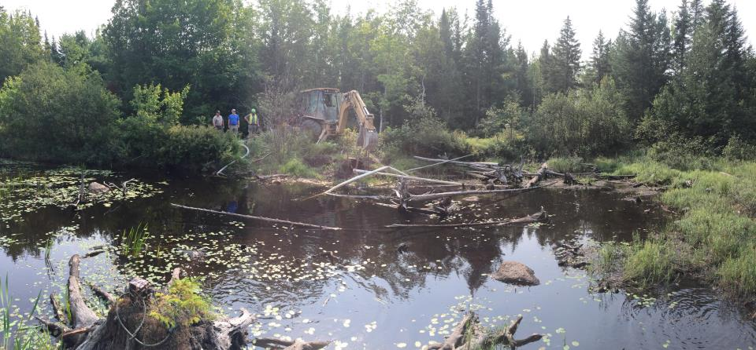
Start of Construction
Looking down to inlet at start of construction Sept 2, 2015

Slide 37
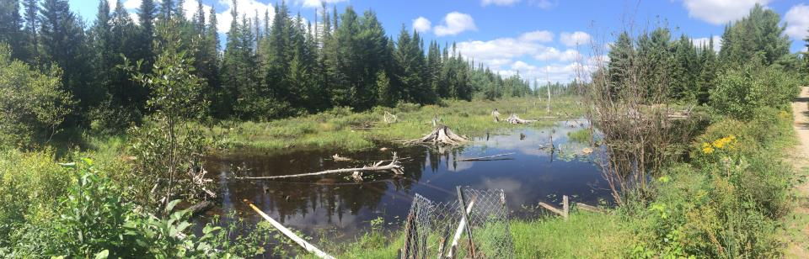
Looking upstream (Sept 2, 2015)

Slide 38
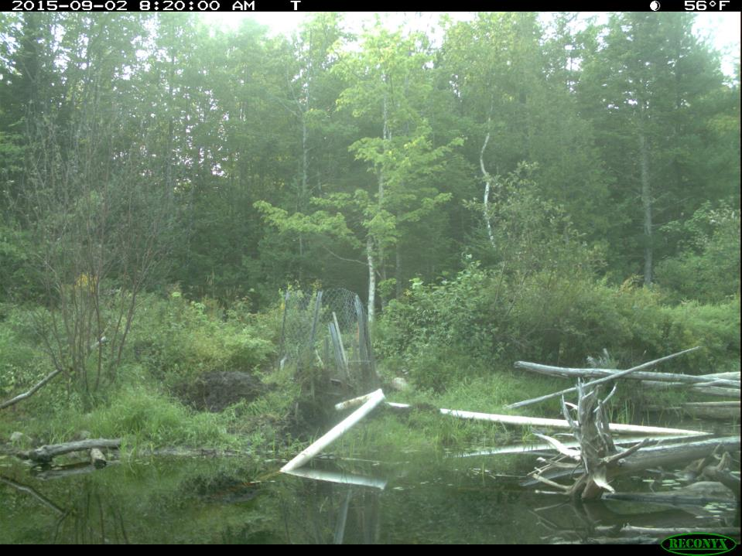
Before

Slide 39
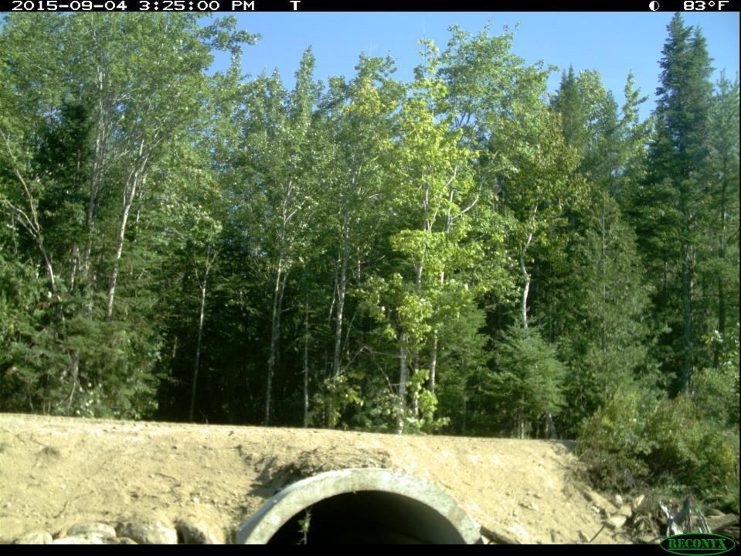
After

